Slide 1

Customer Order Prediction: Detailed Project Report

Slide 2

Introduction
1
Overview
2
Objective
The Customer Order Prediction system aims to forecast customer purchasing behavior based on historical transaction data. By leveraging machine learning techniques, this system assists businesses in optimizing inventory levels, reducing costs associated with overstocking or stockouts, and enhancing customer satisfaction.
The primary goal of this project is to develop a predictive model that can accurately predict future customer orders. The system will be designed to ingest and clean historical transaction data, engineer meaningful features from raw data, train a machine learning model to predict customer order amounts, and expose the trained model via an API for real-time predictions.

Slide 3
Problem Statement
Inventory Management Challenges
Data-Driven Solution
E-commerce businesses face significant challenges in managing inventory due to fluctuations in customer demand. Stockouts and overstocking can lead to revenue losses and increased operational costs.
A data-driven predictive system is required to accurately forecast customer orders, enabling proactive inventory management and ensuring product availability.

Slide 4
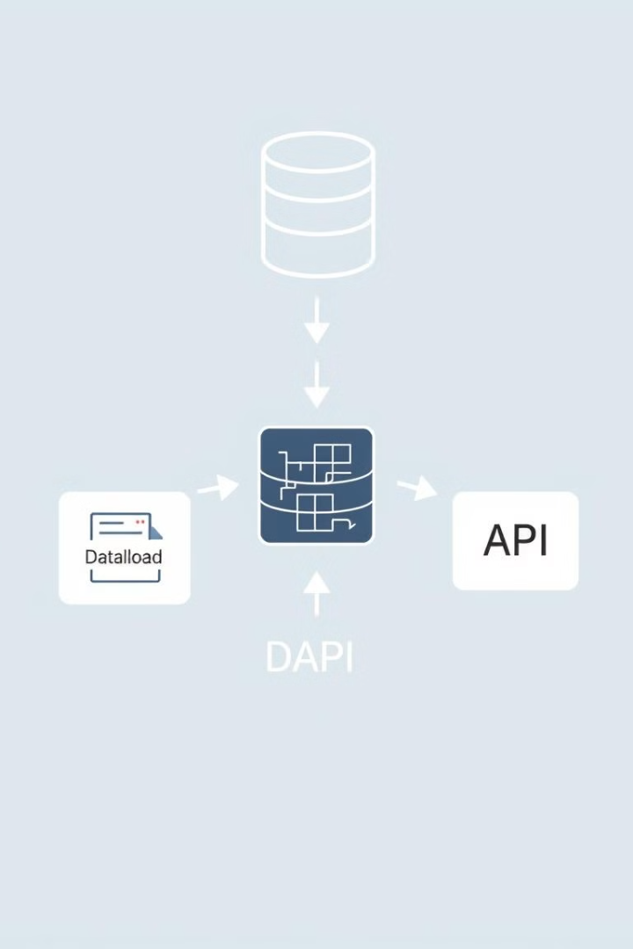
Proposed Solution
Data Ingestion
Collects and loads data from CSV files or databases.
Data Processing & Feature Engineering
Cleans the data and generates useful features.
Model Training
Trains a Random Forest model using the processed data.
API Development
Exposes the trained model for real-time predictions.

Slide 5
Architecture
1
Data Sources
CSV files or databases.
2
Data Ingestion
Loads and validates the data.
3
Data Cleaning
Handles missing values, removes duplicates, and ensures consistent formatting.
4
Feature Engineering
Generates useful features from the raw data.
5
Machine Learning Model
Trains a Random Forest model to predict customer order amounts.
6
Model Storage
Stores the trained model for future use.
7
API Layer
Exposes the trained model for real-time predictions.
8
Client Applications
Access the API for predictions.

Slide 6
Data Overview
BillNo
Itemname
Quantity
Price
CustomerID
1283
Eggs
4
4.85
39921
1283
Tomatoes
2
4.86
40389
1285
Apples
5
3.02
12894
1287
Cheese
1
6.09
82102

Slide 7

Data Processing and Feature Engineering
1
Data Cleaning
Handles missing values, removes duplicates, and ensures consistent formatting across the dataset.
2
Feature Engineering
Generates new features from the raw data to improve model performance. For instance, TotalQuantity: The total number of items in each transaction. AveragePrice: The average price per item in each transaction.

Slide 8




Model Development
Model Selection
We selected a Random Forest Regressor for predicting customer order amounts due to its robustness in handling numerical and categorical data.
Model Training
The model is trained on the engineered features (TotalQuantity, AveragePrice) to predict total spending in each transaction.
Model Evaluation
The model is evaluated using Mean Squared Error (MSE) to measure its performance on the test data.

Slide 9



API Development
API Design
A Flask API is built to expose the model for real-time predictions. Users can send a JSON request containing the feature data, and the API will return the predicted order amount.
API Endpoint
Endpoint: /predict_order Method: POST Input: JSON payload with features. Output: Predicted order amount.

